Slide 1
Air Quality Modeling for 2015 Ozone NAAQS Transport June 1, 2022

Slide 2
Presentation Overview
Four step transport framework
Air quality modeling platform
Scenarios modeled
Model evaluation
Methods for projecting future year ozone design values
Future year ozone nonattainment and maintenance receptors
Ozone contribution modeling
Method for calculating contributions
Upwind states linked to downwind ozone problems
Available modeling documentation and data

Slide 3
Four Step Transport Framework
EPA evaluates interstate transport using a 4-Step framework to quantify necessary emissions reductions to address interstate ozone pollution (defined as “significant contribution”).
Identify monitoring sites that are expected to have problems attaining or maintaining the NAAQS (i.e., nonattainment and maintenance “receptors”)
Determine which upwind states are ‘‘linked’’ to air quality problems in other (i.e., downwind) states for further analysis of their emissions​. (“linked” upwind staes contribute at/above 1 percent of the NAAQS to one or more downwind receptors)
For states linked to downwind receptors, identify upwind emissions on a statewide basis that significantly contribute to nonattainment or interfere with maintenance of a standard in any area, considering cost- and air-quality-based factors.
For upwind states that are found to have emissions that significantly contribute to nonattainment or interfere with maintenance of the NAAQS downwind, implement the necessary emissions reductions within the state.

Slide 4
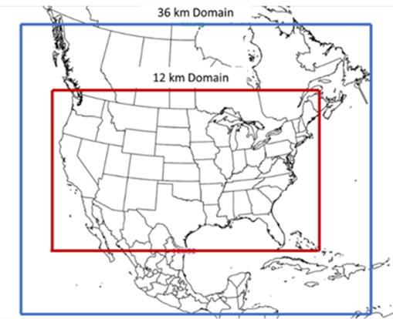
Air Quality Modeling Platform
AQ model: CAMx v7.10
Meteorological model: WRF v3.8
Modeling domains:
36 km “US3” domain
12 km “US2” domain (1-way nested inside 36US3)
Boundary conditions for 36US3:
Hemispheric CMAQ v3.1.1 @108 km resolution
Emissions: 2016v2 emissions modeling platform

Slide 5
Scenarios Modeled
Analytic Year | Scenario | Case Name | Simulation Period
2016 | Base Year | 2016fj | Annual
2023 | Baseline | 2023fj | Annual
 | State Total Anthropogenic Contributions | 2023fj_ussa | May - September
2026 | Baseline | 2026fj | Annual
 | State Total Anthropogenic Contributions | 2026fj_ussa | May - September
 | State EGU Contributions | 2026fj_egusa | April - September
 | State Non-EGU Contributions | 2026fh_nonegusa | April - September
 | State EGU + Non-EGU 30% NOx cut | 2026fj_30nox | May - September
2032 | Baseline | 2032fj | May - September

Slide 6
2016 Model Performance for MDA8 Ozone
Purpose - examine the ability of the 2016 air quality modeling platform to represent the magnitude and spatial and temporal variability of measured (i.e., observed) maximum daily average (i.e., MDA8) ozone concentrations within the modeling domain.
MDA8 ozone model performance statistics and graphics were produced using the Atmospheric Model Evaluation Tool (AMET).
Statistics for individual monitoring sites and in aggregate for each of the nine US climate regions.
Regional statistics were calculated over the period May through September and by month for this time period.
Time series plots of observed/predicted MDA8 ozone for May through September were prepared for each region and for selected individual monitoring sites.
Details on the model performance evaluation and results can be found in Appendix A of the AQ Modeling TSD.

Slide 7
Approach for Judging Model Performance
The acceptability of the 2016 modeling system is judged by considering the evaluation results in light of model performance found in recent ozone model applications, as summarized in Emery et. al., 2017 and Simon et. al., 2012.
From Emery et. al.,
About a third of the top performing past applications have normalized mean bias and a normalized mean error for MDA8 ozone of less than +5 percent and less 15 percent, respectively.
Two-thirds of past applications have normalized mean bias less than +15 percent and normalized mean error less than 25 percent.
These “benchmarks” are not intended to represent “rigid pass/fail tests” but rather as “simple references to the range of recent historical performance” that can be used to understand where the performance results of a particular application “fall in the spectrum of past published results.”
Overall, the ozone model performance results for the 2016v2 CAMx simulation are in large part within the range found in other recent peer-reviewed and regulatory applications.

Slide 8
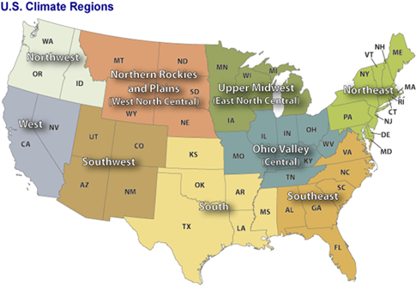
Performance Statistics by Region
Performance statistics for MDA8 ozone for the period May through September (all days).
Climate Region | # of Site-Days | MB | ME | NMB | NME
 |  | (ppb) | (ppb) | (%) | (%)
Northeast | 27,724 | 0.2 | 6.3 | 0.6 | 14.3
Ohio Valley | 33,784 | 0.4 | 6.3 | 1.0 | 14.1
Midwest | 16,279 | -2.9 | 6.3 | -6.9 | 15.2
Southeast | 26,500 | 1.9 | 6.1 | 4.7 | 14.9
South | 21,427 | 0.0 | 6.6 | 0.0 | 16.5
Southwest | 17,469 | -3.9 | 6.9 | -7.4 | 13.4
Northern Rockies | 8,608 | -3.5 | 6.2 | -8.0 | 14.0
Northwest | 4,012 | 0.1 | 6.5 | 0.2 | 17.5
West | 29,789 | -3.1 | 7.4 | -6.0 | 14.5

Slide 9
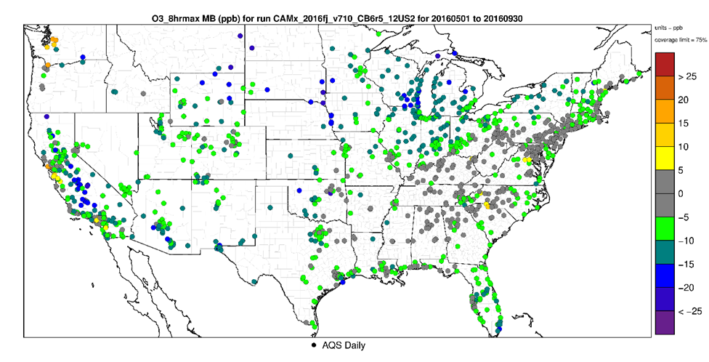
Performance Statistics Nationally
May – Sept Mean Bias (ppb) of MDA8 ozone > 60 ppb
High observed values tend to be under-predicted, on average, nationwide.
In general, the seasonal mean bias for MDA8 ozone ≥ 60 ppb is close to or within + 10 ppb in nearly all of the regions.
The exceptions are the Midwest and Northern Rockies where the mean bias shows under prediction of approximately 12 ppb.

Slide 10
Time Series by Region
Northern Rockies
Northeast
Southwest
Southeast
Southwest
West
West
South

Slide 11
Methods for Projecting Future Year Ozone Design Values
2016 base year MDA8 model predictions were coupled with future year predictions to calculate Relative Response Factors (RRFs) for each monitoring site.
EPA used the “3x3” grid cell approach and the “no water” cell approach that affects RRFs for monitors in coastal areas.
The RRFs were applied to base period (2016 to 2018) 5-year weighted average and maximum design values at individual monitoring sites (concurred exceptional events removed).
Average values are used to represent design values that minimize (i.e., “average out”) the effects of interannual variability in ozone conducive meteorology on ozone design values
Maximum values are used to represent times when meteorological conditions are most conducive for high ozone concentrations.

Slide 12
Ozone Nonattainment and Maintenance Receptors
Nonattainment Receptors
Measuring nonattainment based on most recent design value data, and
Projected future year average design values above the NAAQS.
Maintenance Receptors
Currently measuring clean data, but projected average design values above the NAAQS, or
Projected average design values are below the NAAQS, but projected maximum design values above the NAAQS

Slide 13
Areas with One or More Receptors Projected in 2023*
Nonattainment
Maintenance
*By 2026, Dallas, El Paso, Las Vegas, and Philadelphia are no longer projected to be receptors.

Slide 14
State Level Ozone Contribution Modeling
CAMx source apportionment technique - Anthropogenic Culpability Assessment (APCA)
Contributions to ozone from chemical reactions between biogenic and anthropogenic emissions are assigned to the anthropogenic category.
Source Tags in the 12 km US2 domain
States – anthropogenic NO_{X} and VOC emissions from each state, individually
Biogenics domain-wide
Initial and boundary concentrations
Tribes – point sources on tribal lands domain-wide
Canada and Mexico combined
Fires – wild and prescribed fires
Offshore – total emissions from offshore marine vessels and offshore drilling platforms.

Slide 15
Method for Calculating Contributions
Interstate contributions are evaluated using an average contribution metric.
(1) Calculate the 8-hour average contribution from each source tag for the time period of the 2023 modeled MDA8 ozone concentration on each day at each monitoring site;
(2) Average the MDA8 concentrations for the top 10 modeled ozone concentration days in 2023 and average the 8-hour contributions for each of these same days for each tag;
(3) Divide the 10-day average contribution for each tag by the corresponding 10-day average concentration to obtain a Relative Contribution Factor (RCF) for each tag at each monitor;
(4) Multiply the 2023 average design value by the corresponding RCFs to produce the average contribution metric value for each tag at each monitoring site in 2023.

Slide 16
Calculation of Contribution Metric Values - Denver/Chatfield Receptor
Month | Day | 2016 MDA8 | 2023 MDA8 | CA | CO | NV | UT | WY | ICBC | BIOG | FIRES | OFFSHORE | TRIBAL | CAN + MEX
8 | 3 | 74.91 | 68.48 | 0.68 | 19.14 | 0.22 | 0.80 | 0.84 | 37.69 | 4.26 | 2.54 | 0.03 | 0.03 | 0.38
8 | 12 | 73.14 | 67.82 | 1.34 | 13.41 | 0.45 | 1.80 | 0.45 | 46.17 | 2.36 | 0.38 | 0.11 | 0.00 | 0.60
7 | 27 | 71.89 | 67.50 | 1.99 | 16.59 | 0.62 | 2.62 | 0.73 | 37.91 | 3.88 | 2.08 | 0.06 | 0.02 | 0.31
6 | 19 | 72.61 | 67.32 | 0.32 | 10.47 | 0.01 | 0.05 | 0.00 | 51.74 | 1.75 | 0.29 | 0.04 | 0.19 | 0.90
7 | 15 | 69.21 | 66.07 | 1.07 | 10.50 | 0.67 | 1.47 | 0.36 | 47.14 | 2.94 | 0.83 | 0.03 | 0.00 | 0.06
6 | 29 | 68.30 | 65.81 | 1.01 | 16.07 | 0.55 | 2.68 | 0.69 | 37.97 | 3.89 | 1.15 | 0.03 | 0.15 | 0.27
6 | 17 | 69.85 | 65.69 | 0.79 | 13.34 | 0.06 | 0.26 | 1.45 | 41.90 | 3.55 | 0.81 | 0.08 | 0.07 | 0.85
7 | 28 | 66.91 | 65.18 | 0.49 | 20.33 | 0.24 | 0.62 | 1.03 | 32.61 | 4.58 | 2.24 | 0.03 | 0.01 | 0.14
7 | 14 | 67.67 | 64.77 | 0.23 | 17.41 | 0.17 | 0.54 | 1.48 | 36.42 | 4.16 | 1.48 | 0.01 | 0.01 | 0.14
8 | 16 | 67.54 | 64.67 | 0.54 | 13.05 | 0.33 | 1.85 | 0.57 | 42.19 | 3.67 | 1.07 | 0.02 | 0.01 | 0.07
2023 Average DV is 71.7 ppb
 |  | 10-Day Avg => | 66.331 | 0.846 | 15.031 | 0.331 | 1.269 | 0.758 | 41.173 | 3.506 | 1.287 | 0.043 | 0.048 | 0.371
 |  | RCFs => |  | 0.013 | 0.227 | 0.005 | 0.019 | 0.011 | 0.621 | 0.053 | 0.019 | 0.001 | 0.001 | 0.006
 |  | Contributions => |  | 0.91 | 16.24 | 0.35 | 1.37 | 0.81 | 44.50 | 3.78 | 1.39 | 0.04 | 0.05 | 0.40
Day-to-day differences in regional transport patterns can result in large day-to-day variations in contributions from individual upwind states.

Slide 17
Calculation of Contribution Metric Values - Denver/Chatfield Receptor
Month | Day | 2016 Obs | 2016 Modeled | 2023 Modeled | CA | CO | NV | UT | WY | ICBC | BIOG | FIRES | OFFSHORE | TRIBAL | CAN + MEX
8 | 3 | 80.25 | 74.91 | 68.48 | 0.68 | 19.14 | 0.22 | 0.80 | 0.84 | 37.69 | 4.26 | 2.54 | 0.03 | 0.03 | 0.38
8 | 12 | 73.00 | 73.14 | 67.82 | 1.34 | 13.41 | 0.45 | 1.80 | 0.45 | 46.17 | 2.36 | 0.38 | 0.11 | 0.00 | 0.60
7 | 27 | 86.63 | 71.89 | 67.50 | 1.99 | 16.59 | 0.62 | 2.62 | 0.73 | 37.91 | 3.88 | 2.08 | 0.06 | 0.02 | 0.31
6 | 19 | 61.50 | 72.61 | 67.32 | 0.32 | 10.47 | 0.01 | 0.05 | 0.00 | 51.74 | 1.75 | 0.29 | 0.04 | 0.19 | 0.90
7 | 15 | 69.13 | 69.21 | 66.07 | 1.07 | 10.50 | 0.67 | 1.47 | 0.36 | 47.14 | 2.94 | 0.83 | 0.03 | 0.00 | 0.06
6 | 29 | 66.00 | 68.30 | 65.81 | 1.01 | 16.07 | 0.55 | 2.68 | 0.69 | 37.97 | 3.89 | 1.15 | 0.03 | 0.15 | 0.27
6 | 17 | 74.25 | 69.85 | 65.69 | 0.79 | 13.34 | 0.06 | 0.26 | 1.45 | 41.90 | 3.55 | 0.81 | 0.08 | 0.07 | 0.85
7 | 28 | 75.88 | 66.91 | 65.18 | 0.49 | 20.33 | 0.24 | 0.62 | 1.03 | 32.61 | 4.58 | 2.24 | 0.03 | 0.01 | 0.14
7 | 14 | 81.00 | 67.67 | 64.77 | 0.23 | 17.41 | 0.17 | 0.54 | 1.48 | 36.42 | 4.16 | 1.48 | 0.01 | 0.01 | 0.14
8 | 16 | 62.75 | 67.54 | 64.67 | 0.54 | 13.05 | 0.33 | 1.85 | 0.57 | 42.19 | 3.67 | 1.07 | 0.02 | 0.01 | 0.07
2023 Average DV is 71.7 ppb
 |  |  | 10-Day Avg => | 66.331 | 0.846 | 15.031 | 0.331 | 1.269 | 0.758 | 41.173 | 3.506 | 1.287 | 0.043 | 0.048 | 0.371
 |  |  | RCFs => |  | 0.013 | 0.227 | 0.005 | 0.019 | 0.011 | 0.621 | 0.053 | 0.019 | 0.001 | 0.001 | 0.006
 |  |  | Contributions => |  | 0.91 | 16.24 | 0.35 | 1.37 | 0.81 | 44.50 | 3.78 | 1.39 | 0.04 | 0.05 | 0.40
Day-to-day differences in regional transport patterns can result in large day-to-day variations in contributions from individual upwind states.

Slide 18
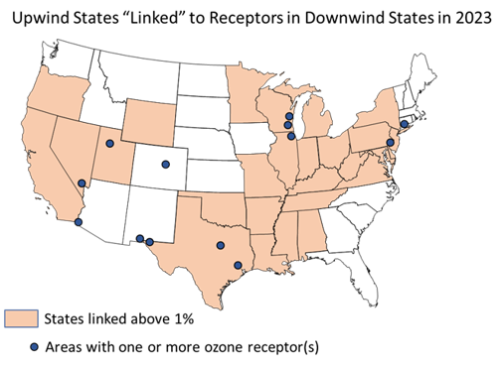
Upwind States that Contribute > 1% of the NAAQS to Downwind Receptors in 2023

Slide 19
Modeling Documentation and Data
Air Quality Modeling Technical Support Document
https://www.epa.gov/csapr/good-neighbor-plan-2015-ozone-naaqs
Emissions Inventory Technical Support Document and Data Summaries
https://www.epa.gov/air-emissions-modeling/2016v2-platform
Data files in the docket
Model performance statistics.
Official ozone design values for 2010 to 2020
Projected design values for 2023, 2026, and 2032
Contributions from each source tag in 2023 and 2026
Air quality modeling input and output files
Available from EPA, upon request
Available now or soon in the IWDW

